Slide 1
CSE214 – Analysis of Algorithms PhD Furkan Gözükara, Toros University https://github.com/FurkanGozukara/Analysis-of-Algorithms-2019
Lecture 3
Solving Recurrences
Based on Cevdet Aykanat’s and Mustafa Ozdal’s Lecture Notes - Bilkent

Slide 2
Solving Recurrences
Reminder: Runtime (T(n)) of MergeSort was expressed as a recurrence
Θ(1)
2T(n/2) + Θ(n)
if n=1
T(n) =
otherwise

Slide 3
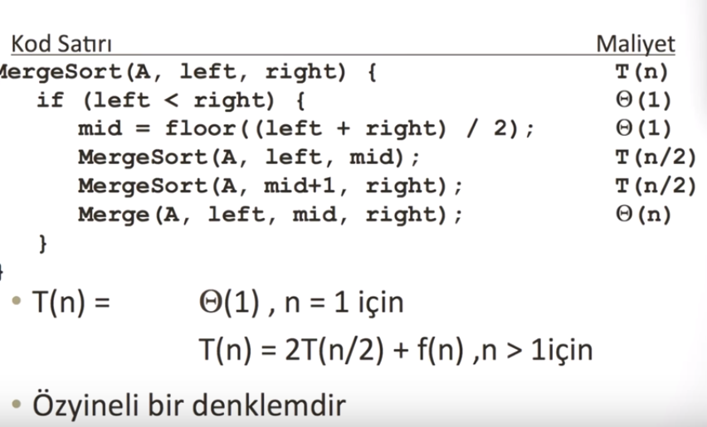

Slide 4
Solving Recurrences
We will focus on 3 techniques in this lecture:
Substitution method
Recursion tree approach
Master method

Slide 5
Substitution Method
The most general method:
Guess
Prove by induction
Solve for constants
Notes:
Induction tüme varım , substitution yerine koyma metodu

Slide 6
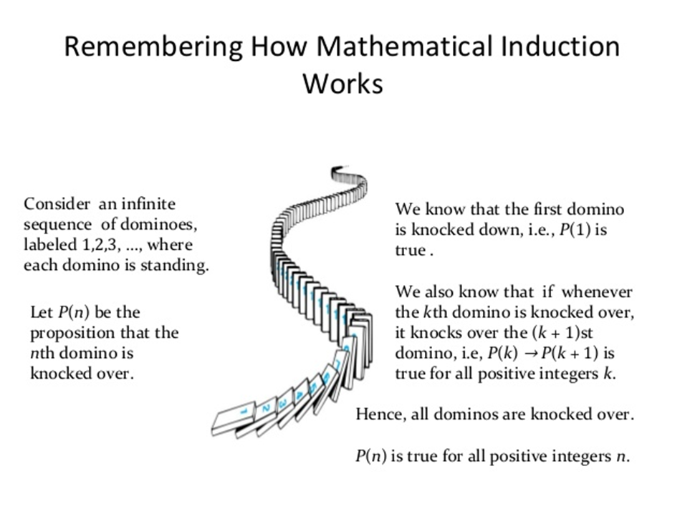
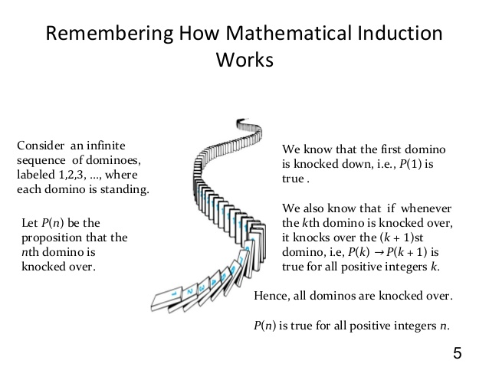

Slide 7
Substitution Method: Example
Solve T(n) = 4T(n/2) + n (assume T(1) = Θ(1))
Guess T(n) = O(n³) (need to prove O and Ω separately)
Prove by induction that T(n) ≤ cn³ for large n (i.e. n ≥ n₀) Inductive hypothesis: T(k) ≤ ck³ for any k < n Assuming ind. hyp. holds, prove T(n) ≤ cn³

Slide 8
Substitution Method: Example – cont’d
Original recurrence: T(n) = 4T(n/2) + n
From inductive hypothesis: T(n/2) ≤ c(n/2)³
Substitute this into the original recurrence: T(n) ≤ 4c (n/2)³ + n
= (c/2) n³ + n
(c/2) n³ + n ≤ cn³ ?
Notes:
Residual artan artık kalıntı

Slide 9

Substitution Method: Example – cont’d
To prove
T(n) ≤ cn³
We can choose c ≥ 2 and n₀ ≥ 1
But, the proof is not complete yet.
Reminder: Proof by induction:
1. Prove the base cases
haven’t proved the base cases yet
Inductive hypothesis for smaller sizes
Prove the general case

Slide 10
Substitution Method: Example – cont’d
We need to prove the base cases
Base: T(n) = Θ(1) for small n (e.g. for n = n₀)
We should show that:
“Θ(1)” ≤ cn³
for n = n₀
This holds if we pick c big enough
So, the proof of T(n) = O(n³) is complete.
But, is this a tight bound?

Slide 11
Example: A tighter upper bound?
Original recurrence: T(n) = 4T(n/2) + n
Try to prove that T(n) = O(n²),
i.e. T(n) ≤ cn² for all n ≥ n₀
Ind. hyp: Assume that T(k) ≤ ck² for k < n
Prove the general case: T(n) ≤ cn²

Slide 12



Example (cont’d)
Original recurrence: T(n) = 4T(n/2) + n
Ind. hyp: Assume that T(k) ≤ ck² for k < n
Prove the general case: T(n) ≤ cn²
T(n)
= 4T(n/2) + n
≤ 4c(n/2)² + n
cn² + n ≤ cn²
= O(n²) Wrong! We must prove exactly

Slide 13
Example (cont’d)
Original recurrence: T(n) = 4T(n/2) + n
Ind. hyp: Assume that T(k) ≤ ck² for k < n
Prove the general case: T(n) ≤ cn²
So far, we have:
T(n) ≤ cn² + n
No matter which positive c value we choose, this does not show that T(n) ≤ cn²
Proof failed?

Slide 14
Example (cont’d)
What was the problem?
The inductive hypothesis was not strong enough
Idea: Start with a stronger inductive hypothesis
◉ Subtract a low-order term
Inductive hypothesis: T(k) ≤ c₁k² – c₂k for k < n
Prove the general case: T(n) ≤ c₁n² - c₂n

Slide 15
Example (cont’d)
Original recurrence: T(n) = 4T(n/2) + n
Ind. hyp: Assume that T(k) ≤ c₁k² - c₂k for k < n
Prove the general case: T(n) ≤ c₁n² – c₂n
T(n)
= 4T(n/2) + n
≤ 4 (c₁(n/2)² – c₂(n/2)) + n
= c₁n² – 2c₂n + n
c₁n² – 2c₂n + n ≤ c₁n² – c₂n
n- c₂n ≤ 0
n(1-c₂) ≤ 0
for n(c₂ – 1) ≥ 0
choose c₂ ≥ 1

Slide 16
Example (cont’d)
We now need to prove
T(n) ≤ c₁n² – c₂n for the base cases.
T(n) = Θ(1) for 1 ≤ n ≤ n₀ (implicit assumption) “Θ(1)” ≤ c₁n² – c₂n for n small enough (i.e. n = n₀)
We can choose c₁ large enough to make this hold
e.g. c₁ = 2, c₂ = 1 , n = 1
We have proved that T(n) = O(n²)
Notes:
Implicit üstü kapalı ima

Slide 17
Substitution Method: Example 2
For the recurrence T(n) = 4T(n/2) + n, prove that T(n) = Ω(n²)
i.e. T(n) ≥ cn²
Ind. hyp: T(k) ≥ ck²
for any n ≥ n₀
for any k < n
Prove general case: T(n) ≥ cn²
T(n)
= 4T(n/2) + n
≥ 4c (n/2)² + n
= cn² + n ≥ cn²
since n > 0
Proof succeeded – no need to strengthen the ind. hyp as in the last example

Slide 18
Example 2 (cont’d)
We now need to prove that T(n) ≥ cn²
for the base cases
T(n) = Θ(1) for 1 ≤ n ≤ n₀ (implicit assumption)
“Θ(1)” ≥ cn²
for n = n₀
n₀ is sufficiently small (i.e. c=1, n=1)
We can choose c small enough for this to hold
We have proved that T(n) = Ω (n²)

Slide 19
Substitution Method - Summary
1. Guess the asymptotic complexity
Prove your guess using induction
Assume inductive hypothesis holds for k < n
Try to prove the general case for n
Note: MUST prove the EXACT inequality CANNOT ignore lower order terms
If the proof fails, strengthen the ind. hyp. and try again
Prove the base cases (usually straightforward)
Notes:
substitution

Slide 20
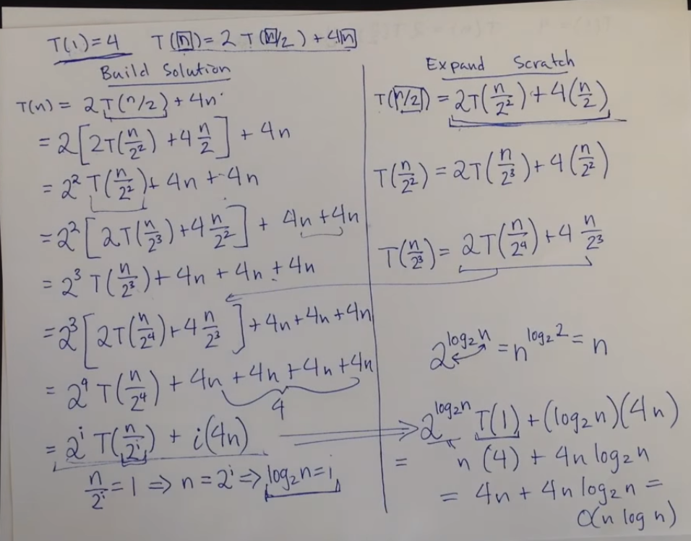

Slide 21
Recursion Tree Method
A recursion tree models the runtime costs of a recursive execution of an algorithm.
The recursion tree method is good for generating guesses for the substitution method.
The recursion-tree method can be unreliable.
◉ Not suitable for formal proofs
The recursion-tree method promotes intuition, however.
Notes:
Intuition sezgi önsezi

Slide 22


Solve Recurrence: T(n) = 2T (n/2) + Θ(n)
Θ(n)
T(n/2)
T(n/2)

Slide 23

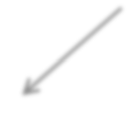

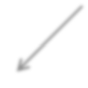
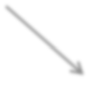
Solve Recurrence: T(n) = 2T (n/2) + Θ(n)
Θ(n)
2x
subproblems
Θ(n/2)
Θ(n/2)
each size
halved
T(n/2)
T(n/4)
T(n/4)
T(n/4)
T(n/4)

Slide 24





Solve Recurrence: T(n) = 2T (n/2) + Θ(n)
Θ(n)
Θ(n)
Θ(n/2)
Θ(n/2)
Θ(n)
lgn
T(n/4)
T(n/4)
T(n/4)
T(n/4)
Θ(1)
Θ(1) Θ(1)
Θ(1)
Θ(1) Θ(1)
Θ(1)
Θ(1)
Θ(1) Θ(n)
₂lgn _{= n}
Total: Θ(nlgn)

Slide 25
Example of Recursion Tree
Solve T(n) = T(n/4) + T(n/2) + n²:

Slide 26
Example of Recursion Tree
Solve T(n) = T(n/4) + T(n/2) + n²:
T(n)

Slide 27
Example of Recursion Tree
Solve T(n) = T(n/4) + T(n/2) + n²:
_{n}2
T(n/4) T(n/2)

Slide 28
Example of Recursion Tree
Solve T(n) = T(n/4) + T(n/2) + n²:
_{n}2
(n/4)² (n/2)²
T(n/16) T(n/8) T(n/8) T(n/4)

Slide 29
Example of Recursion Tree
Solve T(n) = T(n/4) + T(n/2) + n²:
_{n}2
(n/4)² (n/2)²
(n/16)² (n/8)² (n/8)² (n/4)²
Θ(1)

Slide 30
Example of Recursion Tree
Solve T(n) = T(n/4) + T(n/2) + n²:
_{n}2
_{n}2
(n/4)²
(n/2)²
(n/16)²
(n/8)²
(n/8)²
(n/4)²
Θ(1)

Slide 31
Example of Recursion Tree
Solve T(n) = T(n/4) + T(n/2) + n²:
_{n}2
_{n}2
(n/4)²
(n/2)²
5/16 n²
(n/16)²
(n/8)²
(n/8)²
(n/4)²
Θ(1)

Slide 32
Example of Recursion Tree
Solve T(n) = T(n/4) + T(n/2) + n²:
_{n}2
_{n}2
(n/4)²
(n/2)²
5/16 n²
(n/16)²
(n/8)²
(n/8)²
(n/4)²
25/256 n²
Θ(1)

Slide 33
Example of Recursion Tree
Solve T(n) = T(n/4) + T(n/2) + n²:
_{n}2
_{n}2
(n/4)²
(n/2)²
5/16 n²
(n/16)²
(n/8)² (n/8)² (n/4)²
25/256 n²
Total = n² (1 + 5/16 + (5/16)² + (5/16)³ + ...)
= Θ(n²) geometric series
Θ(1)

Slide 34
Geometric Series Reminder
for |x| < 1
for x ≠ 1

Slide 35
The Master Method
A powerful black-box method to solve recurrences (solving divide and conquer type problems).
The master method is utilized for algorithms that divides problem into a times n/b size pieces
T(n) = aT(n/b) + f (n)
where a ≥ 1, b > 1, and f is asymptotically positive.

Slide 36
The Master Method
The cost of every step is calculated (e.g. dividing cost, merge cost of the pieces, etc.) and sum of these costs are shown as f (n)
Then the master method formula is used to have guess of the run time cost of the algorithm

Slide 37
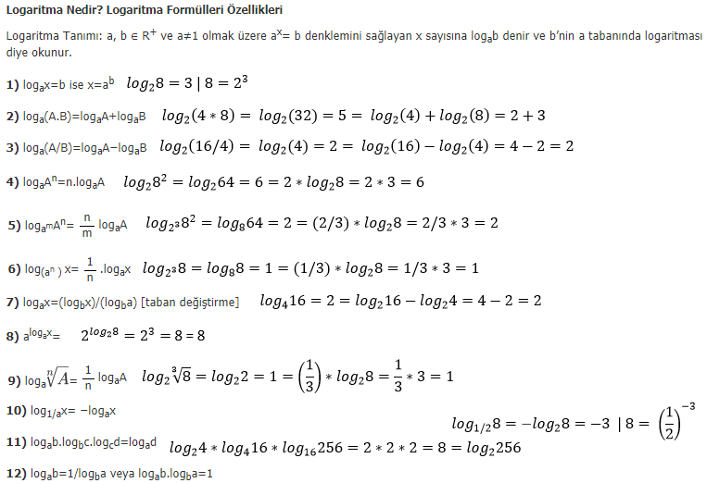

Slide 38
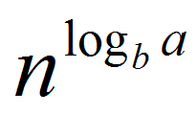
The Master Method: 3 Cases
Recurrence: T(n) = aT(n/b) + f (n)
_{n}log_{b} a
Compare f (n) with
Intuitively:
Case 1: f (n) grows polynomially slower than
Case 2: f (n) grows at the same rate as n^{logb a}
Case 3: f (n) grows polynomially faster than
Notes:
1 master method sorarim

Slide 39

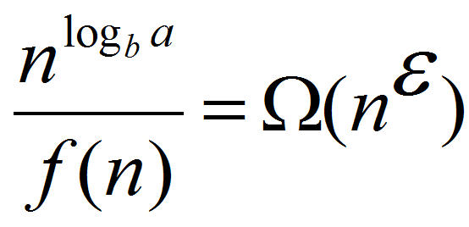

The Master Method: Case 1
Recurrence: T(n) = aT(n/b) + f (n)
Case 1: for some constant ε > 0
i.e., f (n) grows polynomialy slower than n^{logb a}
(by an n^{ε} factor).
Solution: T(n) = Θ(n^{logb a} )

Slide 40

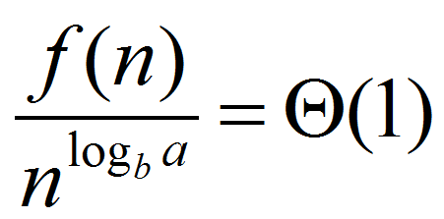

The Master Method: Case 2 (simple version)
Recurrence: T(n) = aT(n/b) + f (n)
Case 2:
i.e., f (n) and n^{logb a}
grow at similar rates
Solution: T(n) = Θ(n^{logb a} lgn)

Slide 41

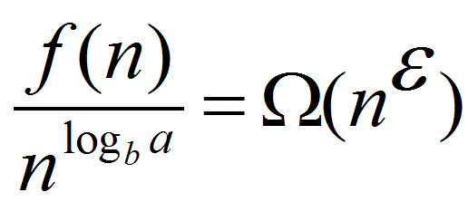


The Master Method: Case 3
Case 3: for some constant ε > 0
i.e., f (n) grows polynomialy faster than n^{logb a} (by an n^{ε} factor).
and the following regularity condition holds:
a f (n/b) ≤ c f (n) for some constant c < 1
Solution: T(n) = Θ( f(n) )

Slide 42
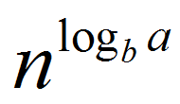

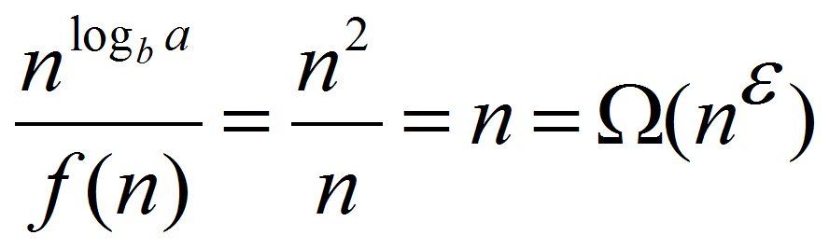
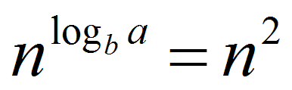

Example: T(n) = 4T(n/2) + n
a = 4
b = 2 f(n) = n
f(n) grows polynomially slower than
for ε = 1
CASE 1
T(n) = Θ( n^{logb a} )
T(n) = Θ(n²)

Slide 43
Example: T(n) = 4T(n/2) + n²
a = 4
b = 2 f(n) = n²
f(n) grows at similar rate as
f(n) = Θ( ) = n²
CASE 2
T(n) = Θ( n^{logb a} lgn)
T(n) = Θ(n²lgn)

Slide 44
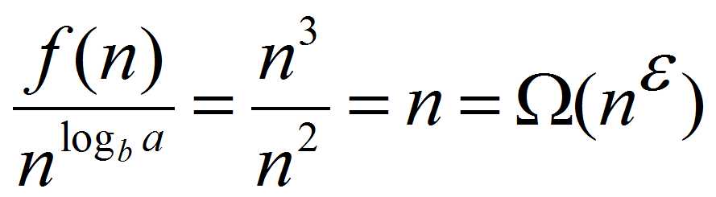

Example: T(n) = 4T(n/2) + n³
a = 4
b = 2 f(n) = n³
f(n) grows polynomially faster than
for ε = 1 seems like CASE 3, but need
to check the regularity condition
Regularity condition: a f (n/b) ≤ c f (n) for some constant c < 1
4 (n/2)³ ≤ cn³ for c = 1/2 CASE 3
T(n) = Θ(f(n)) T(n) = Θ(n³)

Slide 45
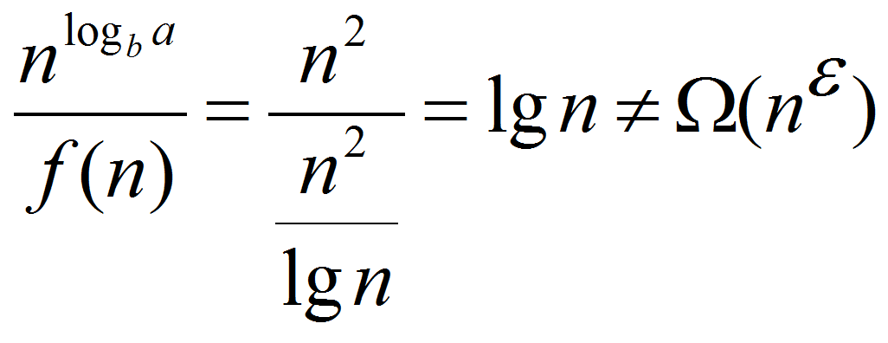
Example: T(n) = 4T(n/2) + n²/lgn
a = 4
b = 2 f(n) = n²/lgn
f(n) grows slower than
but is it polynomially slower?
for any ε > 0
is not CASE 1
Master method does not apply!

Slide 46

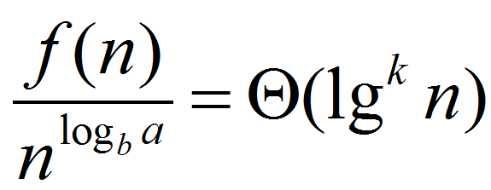

The Master Method: Case 2 (general version)
Recurrence: T(n) = aT(n/b) + f (n)
Case 2: for some constant k ≥ 0
Solution: T(n) = Θ ( n^{logb a} lg^{k+1}n)

Slide 47
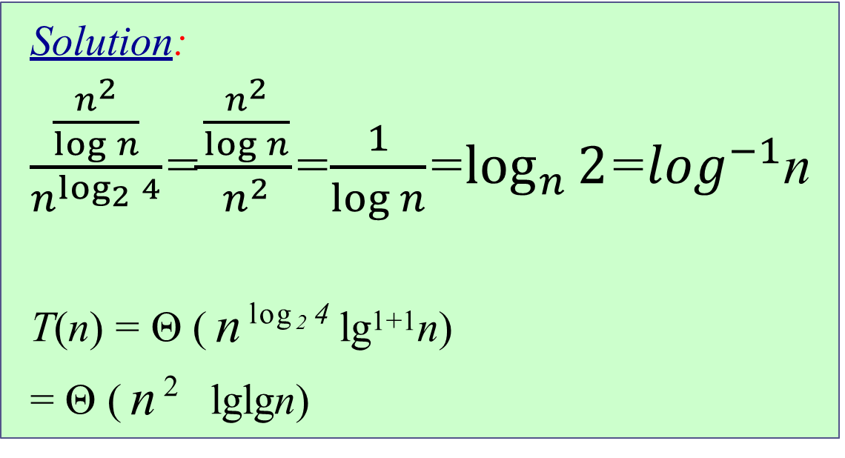
Example: T(n) = 4T(n/2) + n²/lgn
a = 4
b = 2 f(n) = n²/lgn
Solution:
$\frac{\frac{n^{2}}{\log{n}}}{n^{\log_{2}{4}}}$=$\frac{\frac{n^{2}}{\log{n}}}{n^{2}}$=$\frac{1}{\log{n}}$=$\log_{n}{2}$=$\log^{−1}$n
T(n) = Θ ( n^{log2 4} lg¹⁺¹n)
= Θ ( n² lglgn)

Slide 48
General Method (Akra-Bazzi)
T (n) = ∑ a_{i}T (n / b_{i} ) + f (n)
i=1
Let p be the unique solution to
k
k
∑
p
(a / b
) = 1
i
i
i =1
Then, the answers are the same as for the master method, but with n^{p} instead of n^{logb a}
(Akra and Bazzi also prove an even more general result.)

Slide 49
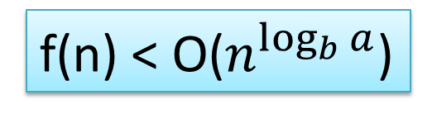
f(n) is smaller than leaf sum.
Case 1 Explained
f(n) < O($n^{\log_{b}{a}}$)
f (n)
f (n)
a
f (n/b)
f (n/b)
…
f (n/b)
a f (n/b)
a
h = log_{b}n
f (n/b²)
f (n/b²)
…
f (n/b²)
a² f (n/b²)
…
…
The sums increase geometrically from the root to the leaves. The leaves hold the biggest part of the total sum.
Τ (1)
n^{logba}Τ (1)
Θ(n^{logba})

Slide 50
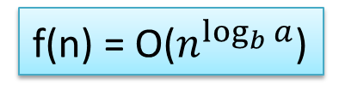
f(n) is roughly equal to the leaf sum.
Case 2 Explained
f(n) = O($n^{\log_{b}{a}}$)
f (n)
f (n)
a
f (n/b)
f (n/b)
…
f (n/b)
a f (n/b)
a
h = log_{b}n
f (n/b²)
f (n/b²)
…
f (n/b²)
a² f (n/b²)
…
…
The sums are approximately the same on each of the levels (Θ(total of all sums)).
Τ (1)
n^{logba}Τ (1)
Θ(n^{logba} * log n)

Slide 51
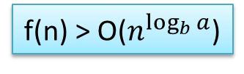
a f(n/b) is getting smaller
at lower levels (see def^{n})
Case 3 Explained
f(n) > O($n^{\log_{b}{a}}$)
f (n)
f (n)
a
f (n/b)
f (n/b)
…
f (n/b)
a f (n/b)
a
h = log_{b}n
f (n/b²)
f (n/b²)
…
f (n/b²)
a² f (n/b²)
…
…
The sums decrease geometrically from the root to the leaves. The root holds the biggest part of the total sum.
Τ (1)
n^{logba}Τ (1)
Θ( f (n))

Slide 52
Proof of Master Theorem: Case 1 and Case 2
Recall from the recursion tree (note h = lg_{b}n=tree height)
T (n) = Θ(n^{logb a} ) +∑ a^{i} f (n / b^{i} )
i=0
h−1
Leaf cost
Non-leaf cost = g(n)

Slide 53
Proof of Case 1
_{n}log_{b} a
ε
➢
= Ω(n )
for some ε > 0
f (n)
_{n}log_{b} a
f (n)
ε
−ε
log a−ε
)
➢
= Ω(n ) ⇒
_{n}log_{b} a
= O(n ) ⇒ f (n) = O(n
b
f (n)
a O((n / b )
⎛
⎞
h−1
)= O⎜
h−1
∑
i
i log a−ε
∑
i
i log a−ε
g(n) =
b
a (n / b )
b
⎟
⎠
⎝ i=0
i=0
⎛
h−1
log a−ε
∑ a b / b
⎞
= O⎜ n
⎝
i iε
i log a
⎟
⎠
b
b
i=0

Slide 54
Case 1 (cont’)
_{a}i_{b}iε
h−1
∑
h−1
= ∑ a^{i}
(b^{ε} )^{i}
εi h−1
= ∑ a^{i b} = ∑(b^{ε} )^{i}
i=0
_{i=0 b}i log_{b} a _{(b}log_{b} a ₎i
_{a}i
i=0
= An increasing geometric series since b > 1
εh h ε log n ε ε
₌ b −1 ₌ (b ) −1 ₌ (b ^{b} ) −1 ₌ n −1 ₌
b^{ε} −1 b^{ε} −1 b^{ε} −1 b^{ε} −1
ε
O(n )

Slide 55
Case 1 (cont’)
_{⎛ n}log_{b} a
g(n) = O(n O(n ))= O⎜
⎞
log a−ε ε
ε
b
O(n ) ⎟
⎜
_{n}ε
⎟
⎝
⎠
= O(n^{logb a} )
T (n) = Θ(n^{logb a} ) + g(n) = Θ(n^{logb a} ) + O(n^{logb a} )
= Θ(n^{logb a} )
Q.E.D.

Slide 56
Proof of Case 2 (limited to k=0)
f (n) n
⎞
⎛
0 log a i
log a
= Θ(lg n) = Θ(1) ⇒ f (n) = Θ(n ) ⇒ f (n / b ) = Θ ( )
⎟
b
⎜
b
log a
i
n ⎝ b
⎠
b
∴ g(n) = ∑ a^{i}Θ((n / b^{i} )^{log a} )
h−1
b
i=0
⎛ h−1
_{n}log_{b} a
⎞ ⎛
∑ a
i=0
= Θ⎜∑ a
h−1
log a
1 ⎞
⎛
h−1
log a
1 ⎞
∑ a
i
⎟ = Θ⎜ n
b
i
⎟ = Θ⎜ n
b
i
⎟
⎜
i log a
⎟
⎜
log a i
⎟
_{a}i ⎠
⎝
b
b
⎠
⎝
(b )
⎠
⎝
i=0
i=0
b
⎛
log n−1
⎞
= Θ(n log n)= Θ(n
b
lg n)
∑1⎟⎟
= Θ⎜⎜ n
log a
b
log a
log a
b
b
b
⎝ ⎠
i=0
T (n) = n^{logb a} + Θ(n^{logb a} lg n)
= Θ(n^{logb a} lg n)
Q.E.D.

